Slide 1
Unit 3: Sealing
Unit 11 – Practice and Assessment

Slide 2
Unit 11 – Practice and Assessment
Lesson 1: Core Manufacturing Skills Review

Slide 3
Course Information
Unit 11 – Practice and Assessment
Lesson 1: Core Manufacturing Skills Review
Lesson 2: Skills Practice Activities
Lesson 3: Assessment of Core Manufacturing Skills
Course Description:
This is the first lesson in this unit dedicated to the review, practice and assessment of basic manufacturing skills. This lesson is a review of those skills.

Slide 4
Lesson Objectives
Upon completion of this lesson, the student will be able to:
Recall skills and knowledge relating to drilling for quality, deburring, and countersinking.
Recall skills and knowledge relating to fastener installation, specifically rivets, Hi-Loks, lockbolts, and standard nuts & bolts.
Notes:
Instructor notes:
1 of 2

Slide 5
Lesson Outline
Practice and Assessment
Tool Identification Review
Review of Manufacturing Skills Processes

Slide 6
Introduction: Core Manufacturing Skills Review - 1
To enter a career in aviation manufacturing, you must show competency in the basic core manufacturing skills used by entry-level aircraft assemblers. All the knowledge and skills you’ve learned in the CorePlus curriculum is valuable, but the basic skills of drilling, countersinking, deburring, and fastener installation are critical.

Slide 7
Introduction: Core Manufacturing Skills Review - 2
One of the first things that any employer will do is test you in these skills. Being familiar with the skills is not enough. Showing competency is a minimum expectation, expertise in these skills is what your future employer will really want to see.
This unit will provide opportunities to further practice your core manufacturing skills that you originally learned during the first year units of Core Plus.

Slide 8
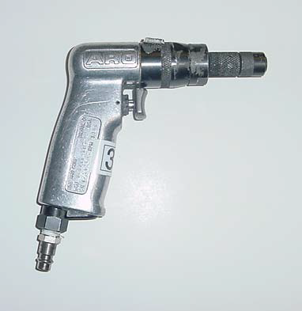
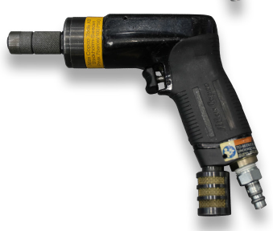
Tool Identification: Pistol Grip Drill Motor
Image courtesy of The Boeing Company
Notes:
Instructor notes:
Image courtesy of The Boeing Company

Slide 9
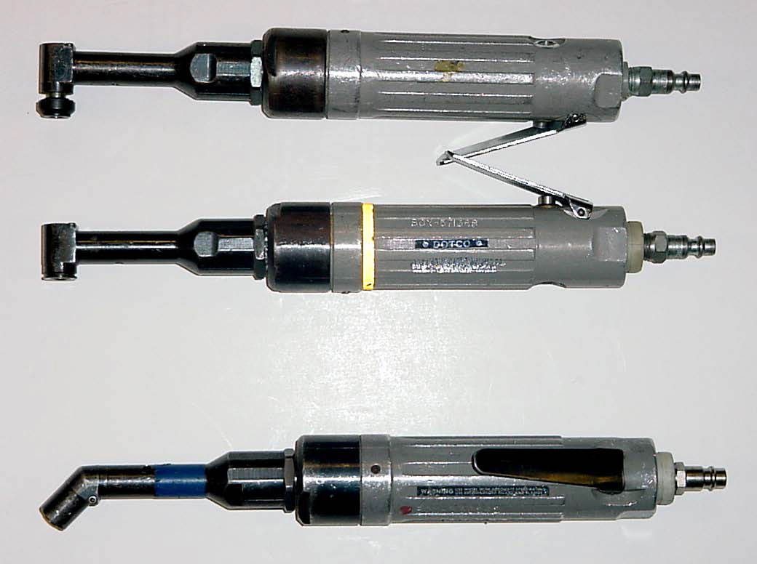
Tool Identification: 90 Degree Drill Motor
Image courtesy of The Boeing Company

Slide 10
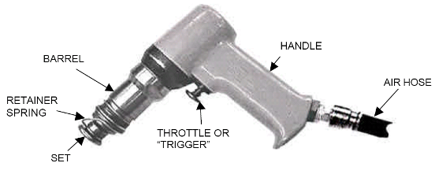
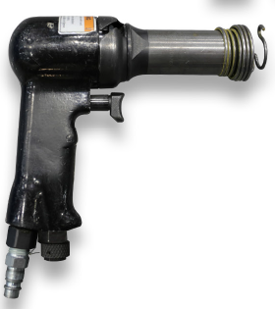
Tool Identification: Rivet Gun
Image courtesy of The Boeing Company

Slide 11
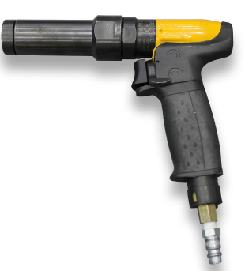
Tool Identification: Cleco® Gun
The item on the right is the Cleco® gun currently used in aviation manufacturing.
Image courtesy of The Boeing Company

Slide 12
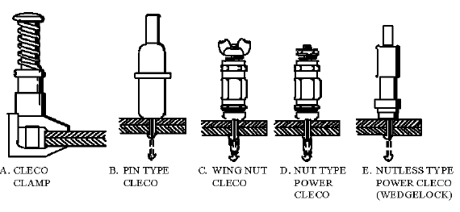

Cleco® ID: Power Cleco®
Item E is an example of a Draw / Power Cleco®.
Image courtesy of The Boeing Company
Notes:
Image courtesy of The Boeing Company

Slide 13
Cleco® ID: Pin Type Cleco®
Item B is known as a Pin Cleco®
Image courtesy of The Boeing Company
Notes:
Image courtesy of The Boeing Company

Slide 14
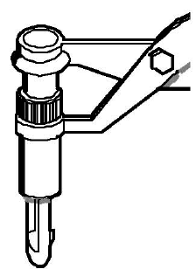

Cleco® ID: Spring Cleco®
Images courtesy of The Boeing Company
Notes:
Image courtesy of The Boeing Company

Slide 15
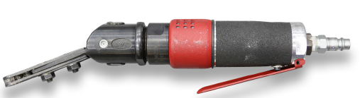
Hi-Lok Runner
Images courtesy of The Boeing Company

Slide 16
Lesson Outline
Practice and Assessment
Tool Identification Review
Review of Manufacturing Skills Processes

Slide 17
Review of Core Plus Units
To prepare for the core manufacturing skills assessment, it is recommended that students review their Core Plus booklets and notes from these first year units:
Unit 5 - Precision Measurement
Unit 6 - Fasteners
Unit 7 - Drilling
Unit 9 - Riveting
Notes:
Instructor notes:
If time allows, the instructor may show the Core Plus presentation slides from those units as a class review of the concepts and skills involved.

Slide 18
Countersinking
Check out this video on countersinking tips:
Video: Countersinking Tips for Flush Rivets (8:34)
https://www.youtube.com/watch?v=ykK37Ms2UiA

Slide 19
Basic Riveting & Removal 1
The link below is a video that covers the basic process of drilling, riveting, and rivet removal.
Video: Aircraft Sheet Metal: Basic Rivet Layout, Installation, and Removal (6:50)
https://www.youtube.com/watch?v=Pk_fAHoru_o
Notes:
Instructor notes:

Slide 20
Basic Riveting & Removal 2
This video is a classic, but it shows how flush riveting is done and why it’s important to aircraft aerodynamics.
Video: HOW IT WORKS: WWII Aircraft Flush Riveting (10:35)
https://www.youtube.com/watch?v=IDbTUt3OG9s
Notes:
Instructor note: Just play the first few minutes of the Aircraft Flush Riveting video. Stop the video at 2:35. If the video begins to explain the “Double Dimple Method,” you’ve gone too far.

Slide 21
Aerospace Riveting
This video provides more useful detail on the aircraft grade riveting process.
Video: Solid Rivet Kit - Aircraft Grade Rivets (5:36)
https://www.youtube.com/watch?v=sTmuFxEN1Mk

Slide 22
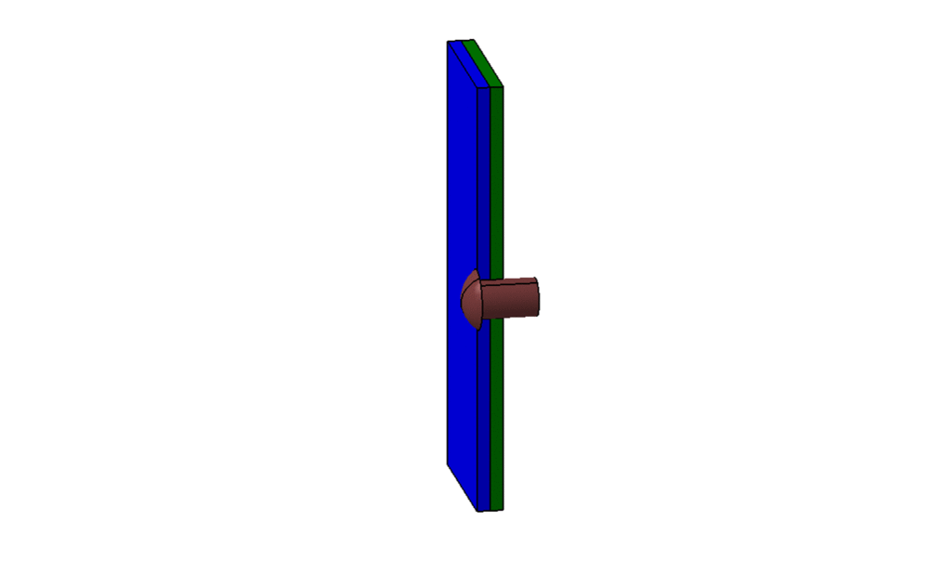
Aerospace Riveting
Rivet Installation Animation
Animation courtesy of The Boeing Company

Slide 23
Lock Bolt and Hi-Lok Installation
Here are two videos on the installation of Hi-Lok fasteners and Huck Bolt fasteners.
Video: Hi-Lok install (:20)
https://www.youtube.com/watch?v=d_Fx0766n3k
Video: Huck Bolt Fastener (:12)
https://www.youtube.com/watch?v=1ae2OBTFNRM

Slide 24
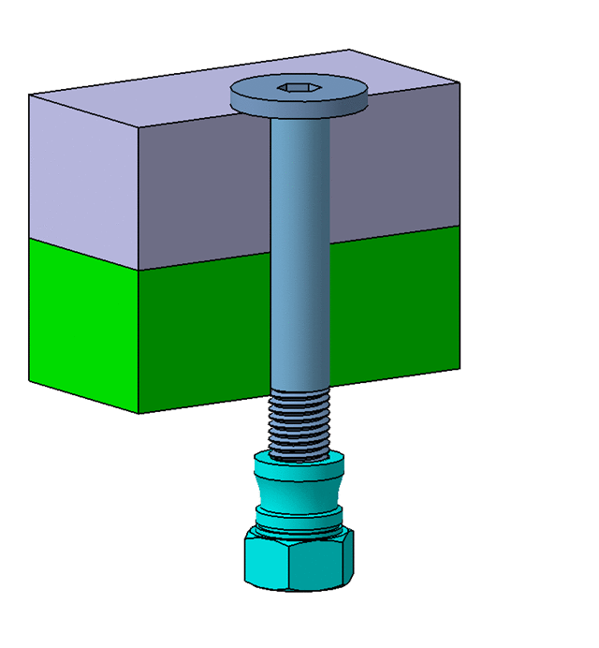
Lock Bolt and Hi-Lok Installation
Hi-Lok Animation
Animation courtesy of The Boeing Company
Notes:
Click for animation. Make sure it is in Presentation Mode.

Slide 25
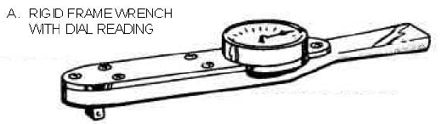
Installation of Torqued Nut and Bolt Fasteners
Here’s an instructional video on installation of nut and bolt fasteners.
Video: Installing Bolt Rivet Nut (:16)
https://www.youtube.com/watch?v=ib5afL3B6ho

Slide 26

Fastener Removal - 1
You will be expected to properly remove all bolts, rivets and fasteners, as if removing defective components. To remove rivets, the head is drilled out carefully using the same diameter drill bit as the original hole size.
Image courtesy of The Boeing Company
Notes:
Instructor notes:
1 of 2

Slide 27
Fastener Removal - 2
Then the remainder of the rivet can be popped out of the hole by driving a pin punch from the side where the rivet head was removed. Make sure the drive pin punch is SMALLER diameter than the drill size you used.
Image courtesy of The Boeing Company
Notes:
Instructor notes:
1 of 2

Slide 28
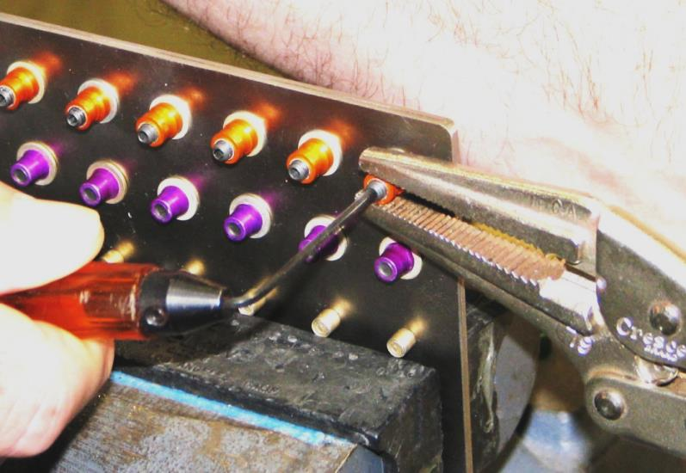
Fastener Removal – Hex Drive and Lock Bolts 1
There are many different tools that are useful in the removal of hex-driven fasteners. For example, an Allen wrench may be used and shown below is another tool, the Locking Pliers.
Use of Locking Pliers to remove permanent fastener
Image courtesy of The Boeing Company
Notes:
Instructor notes:
1 of 2

Slide 29
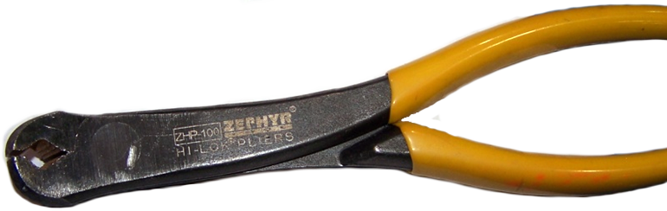
Fastener Removal – Hex Drive and Lock Bolts 2
There is a tool specifically made to remove certain collars: Hi-Lok Collar Pliers.
Locking pliers (often referred to as Vise-Grips®) can be used in the same way.
Hi-Lok Collar Pliers
Image courtesy of The Boeing Company
Notes:
Instructor notes:
1 of 2

Slide 30
Lesson Objectives
Now that you’ve completed this lesson, the student should be able to:
Recall skills and knowledge relating to drilling for quality, deburring, and countersinking.
Recall skills and knowledge relating to fastener installation, specifically rivets, Hi-Loks, lockbolts, and standard nuts & bolts.
Notes:
Instructor notes:

Slide 31
Conclusion
Now that we have reviewed basic manufacturing concepts and skills that were covered in the previous year’s Core Plus, you will have opportunities to practice those skills in a series of hands-on activities.
A short written quiz will be given first, which will assess your recall of concepts reviewed in this lesson.

Slide 32
Acknowledgements
Aerospace Joint Apprenticeship Committee (AJAC), American Society of Metals (ASM), The Boeing Company, National STEM Consortium (NSC), Skills Inc., Washington Manufacturing Advanced Training Institute (WMATI)
About These Materials
Copyright
© 2015 by Washington Manufacturing Advanced Training Institute (WMATI)
The CorePlus: Manufacturing Skills Curriculum is a collaboration among Boeing, and WMATI.
License
Unless otherwise specified, this work is licensed under a Creative Commons Attribution-ShareAlike 4.0 International License.
Attribution
To attribute this course reference Washington Manufacturing Advanced Training Institute (WMATI).
Citation
To cite this course use the following citation example:
Washington Manufacturing Advanced Training Institute (WMATI). CorePlus Manufacturing Skills Curriculum: Safety Course. [URL if applicable.] CorePlus, 2015.
Disclaimer
This workforce solution was built from open license materials from many sources. There are no guarantees, warrantees, or assurances of any kind, express or implied, with respect to such information, including any information on linked sites and including, but not limited to, accuracy of the information or its completeness, timeliness, usefulness, adequacy, continued availability, or ownership.

