Slide 1


Slide 2
Transformation:
PowerPoint to Storyboard
Kim Wheeler
August, 2009

Slide 3
Welcome…
Coastal Technologies!
Began using Coastal in 2006 for Safety CBT’s.
Began developing our own skill based CBT’s in December of 2007.

Slide 4

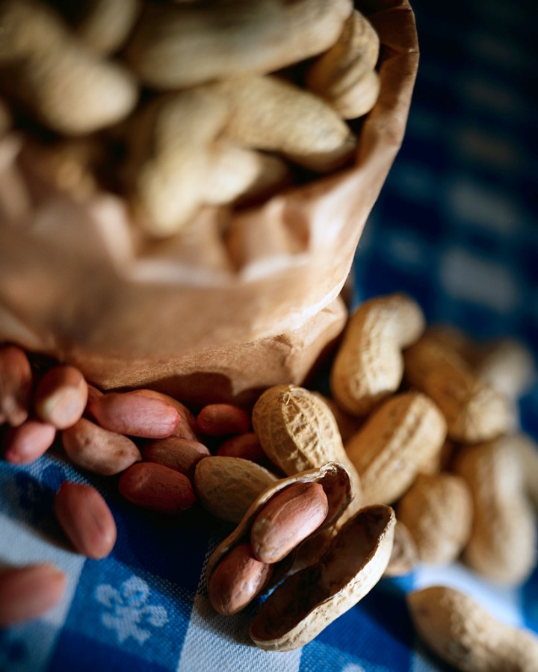
Popcorn, Peanuts, Soda?

Slide 5
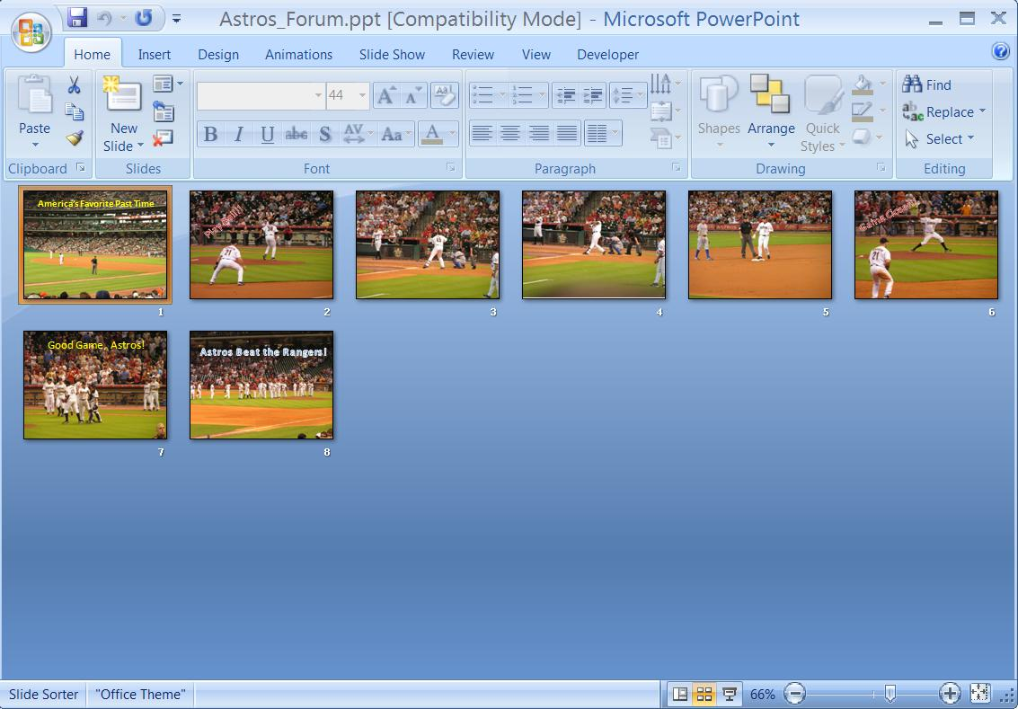
PowerPoint Slide Show

Slide 6
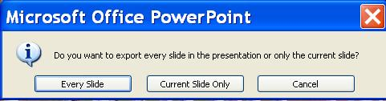
Save As…

Slide 7
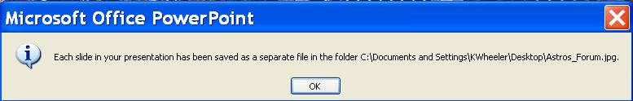
One Slide or More?

Slide 8
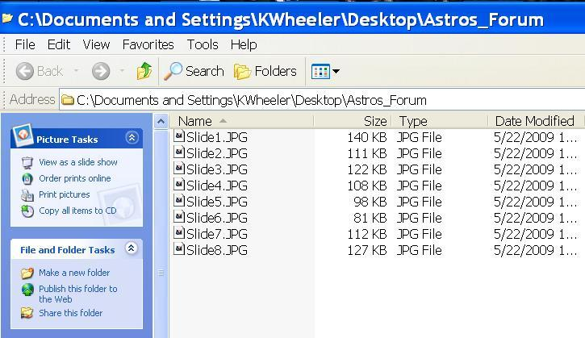
New Folder

Slide 9
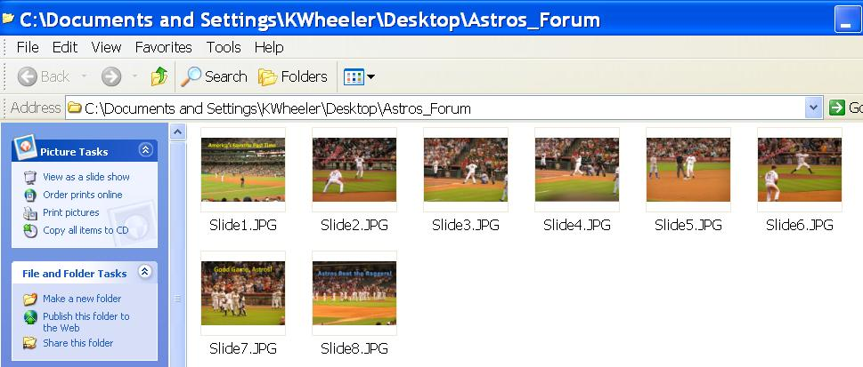
Look Familiar?

Slide 10
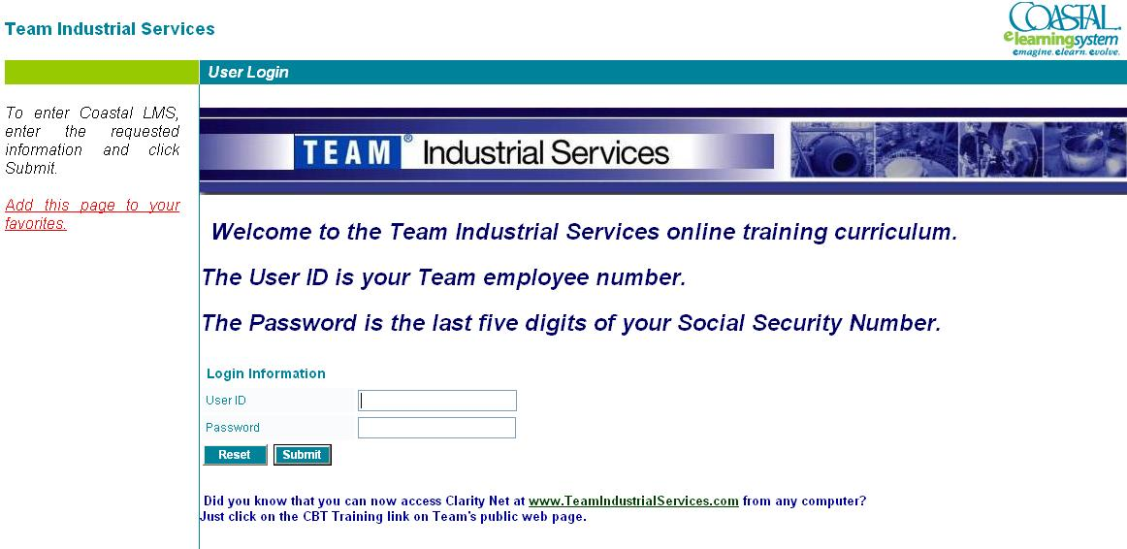

Slide 11
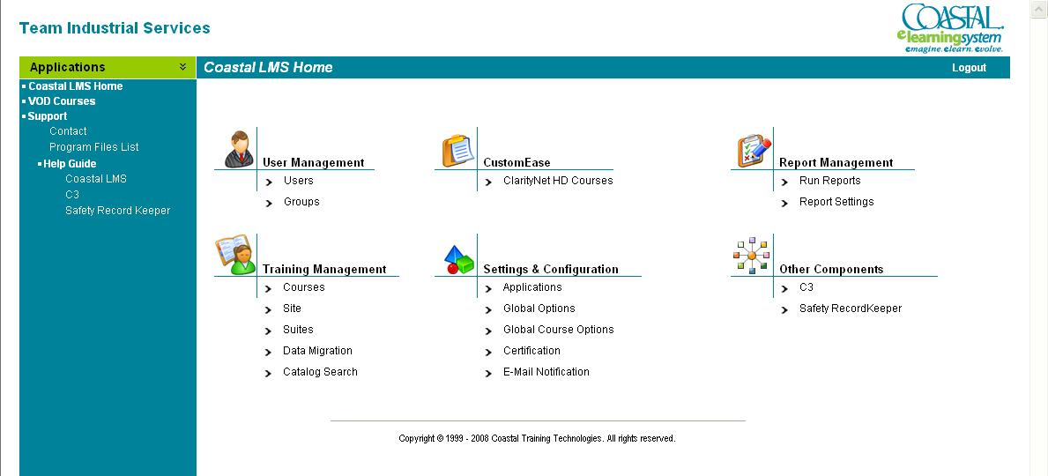

Slide 12
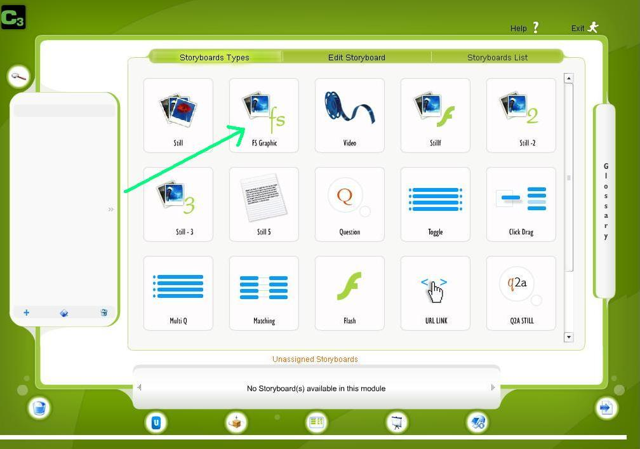
Storyboard Types

Slide 13
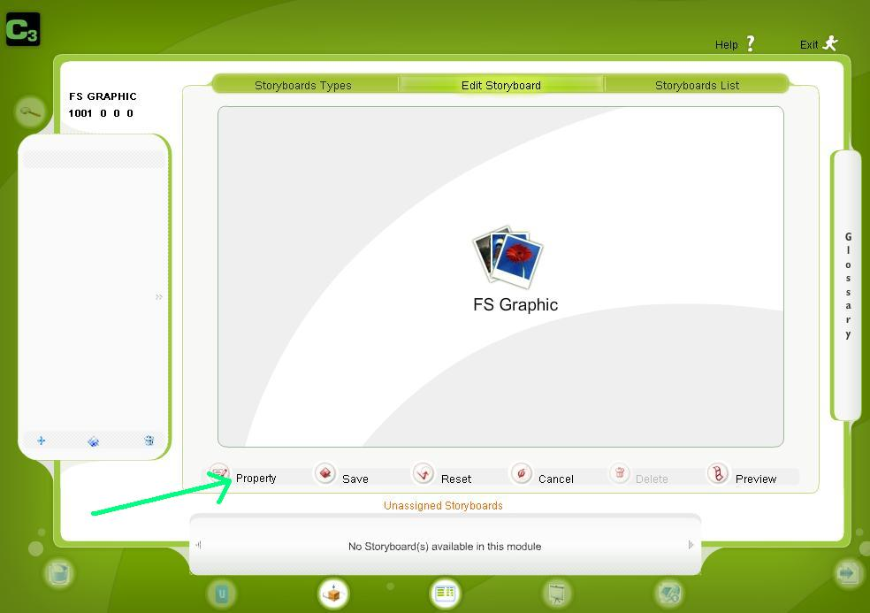
Property Link

Slide 14
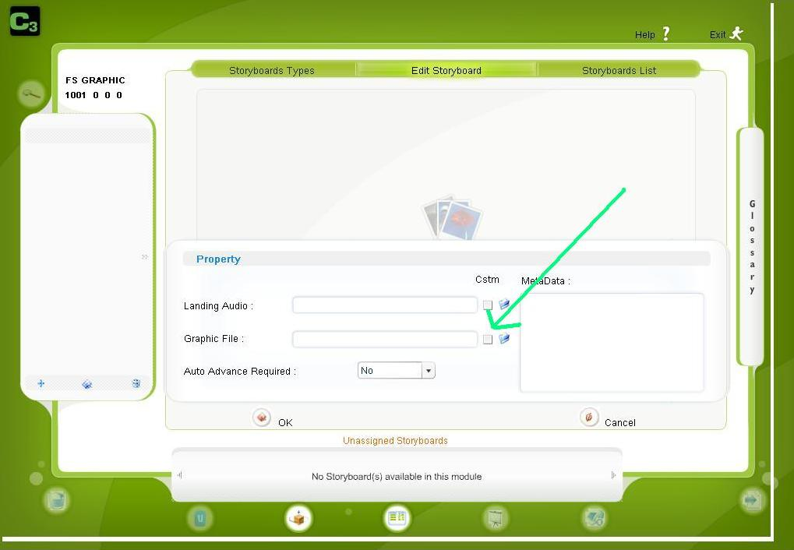
Graphic File Upload

Slide 15
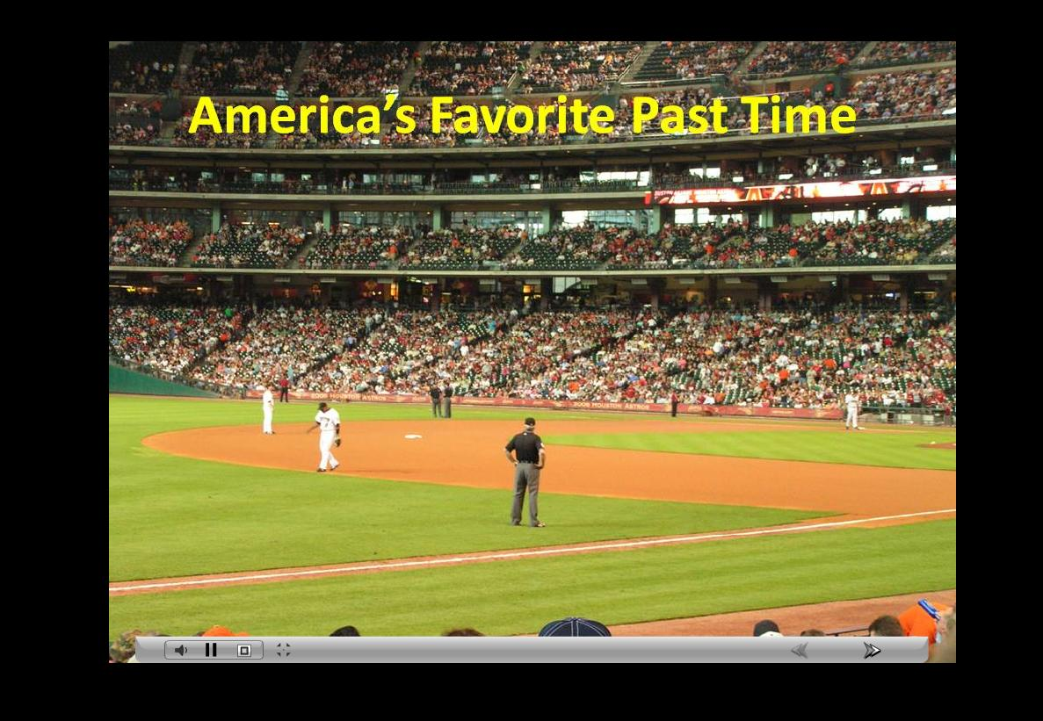
Full Screen Storyboard

Slide 16


Slide 17
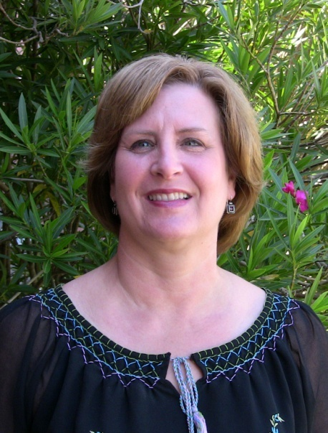
Contact Information:
Kim Wheeler
200 Hermann Drive
Alvin, Texas 77511
281.388.4416
Fax 281.756.3186
www.teamindustrialservices.com
Kim.wheeler@teaminc.com

